Slide 1




WeServe
Community
Service
Under the guidance of: Prof. Anupam Rana

Slide 2

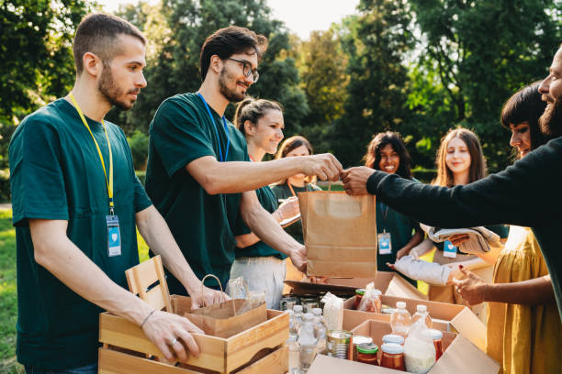
Overview
About Us
Background Information
Competitive Analysis
Problem Statement
Survey
Users
WeServe
Thank You
01
02
03
04
05
06
07
08

Slide 3


WeServe
About Us
Our app connects individuals and organizations to drive community impact. From volunteer events and NGO donations to problem reporting and emergency support, we make it easy to take action. With a user-friendly design, we empower communities to collaborate, contribute, and create meaningful change.
Giving made simple!
Impact made visible!!

Slide 4


Background Information
Struggles
Lack of Organized Volunteering – Many people want to help but struggle to find structured opportunities to volunteer or participate in events.
Difficulty in Donating Essentials – Donors often don't know where or how to donate food, clothes, and other essentials efficiently. NGOs also face challenges in collecting and distributing resources.
Emergency Assistance Gaps – Elderly individuals and vulnerable people often struggle to get immediate help in emergencies, highlighting the need for a quick SOS feature.

Slide 5

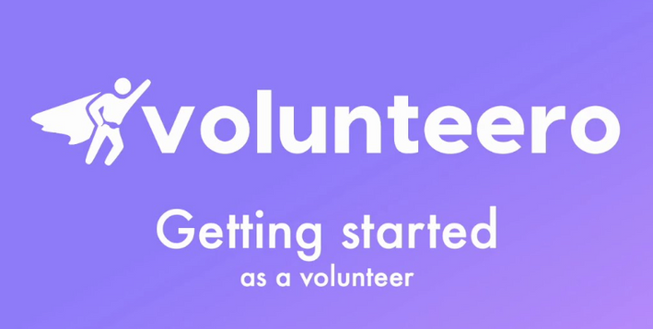
Competitive Analysis
Volunteero
Description of the App
Volunteero is a volunteer management app that helps volunteers and charities connect easily. Available on the Play Store, it lets users find, apply for, and manage opportunities based on their interests and location.
Why is “We Serve” better?
“We Serve" is a community-first app that expands on platforms like Volunteero by combining volunteer coordination, local issue reporting, NGO support, and emergency SOS tools—all in one place. It empowers individuals and organizations to take action, stay safe, and make a real impact.

Slide 6



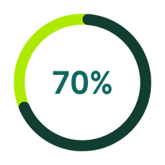
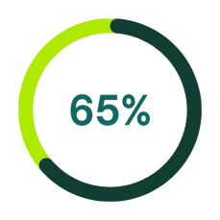
Survey (Demographics)
Gender
Both Males and Females participated in the survey
Participation
The data shows that mojority of the people have participated in the communnity serviees before.

Slide 7
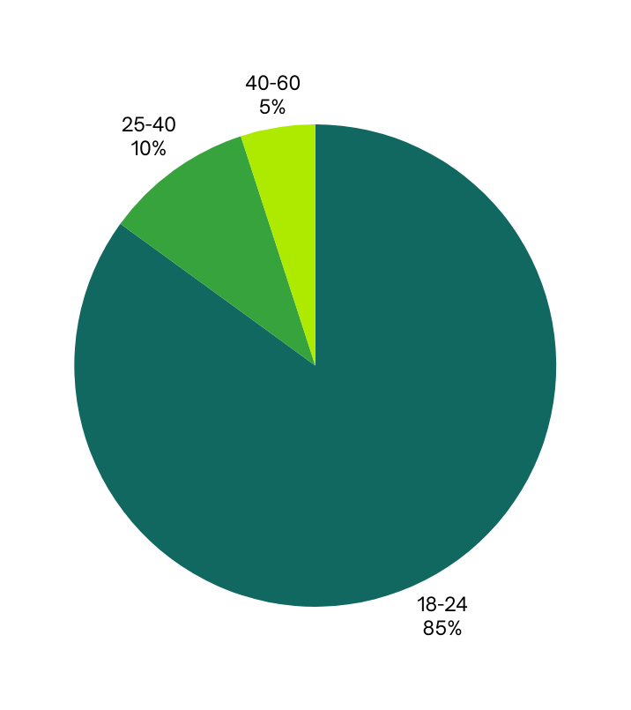
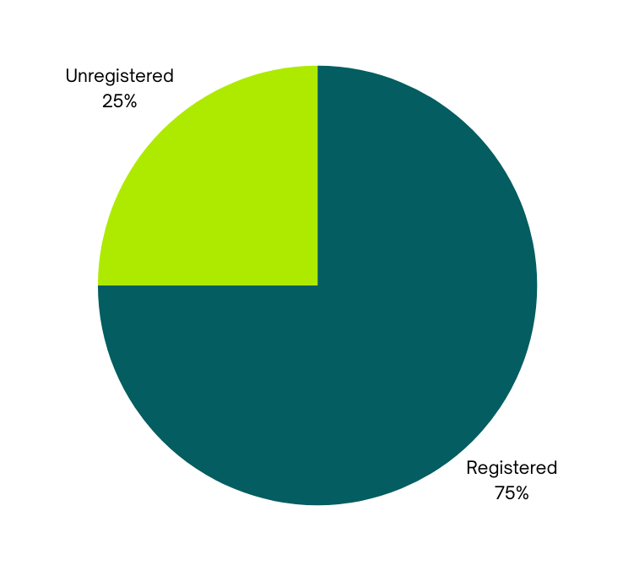
Survey (Demographics)
Type of organizations that
should be listed
Age Group

Slide 8
Survey (Key Takeaways)
Community Issues to Address:
Transparency in donations​
Food wastage
Local problems (e.g., potholes, garbage)​
Access to emergency resources​
Event Interests:
Educational workshops​
Environmental clean-ups ​Wikipedia
Social and cultural events​
Health and fitness activities​
Surplus Food Reporting: Respondents are willing to report surplus food if the process is quick and easy.​
Gamification: Generally viewed as motivating

Slide 9
Problem Statement
Despite a strong willingness among individuals to contribute to their communities, existing platforms lack an integrated space that addresses diverse community needs—ranging from volunteering and donations to local issue reporting and emergency assistance. Survey responses highlight a demand for a user-friendly app that not only connects people with meaningful service opportunities but also ensures transparency, safety, and real-time impact. There is a clear need for a digital solution that empowers citizens and organizations to engage, report, and respond efficiently—all within a single platform.

Slide 10
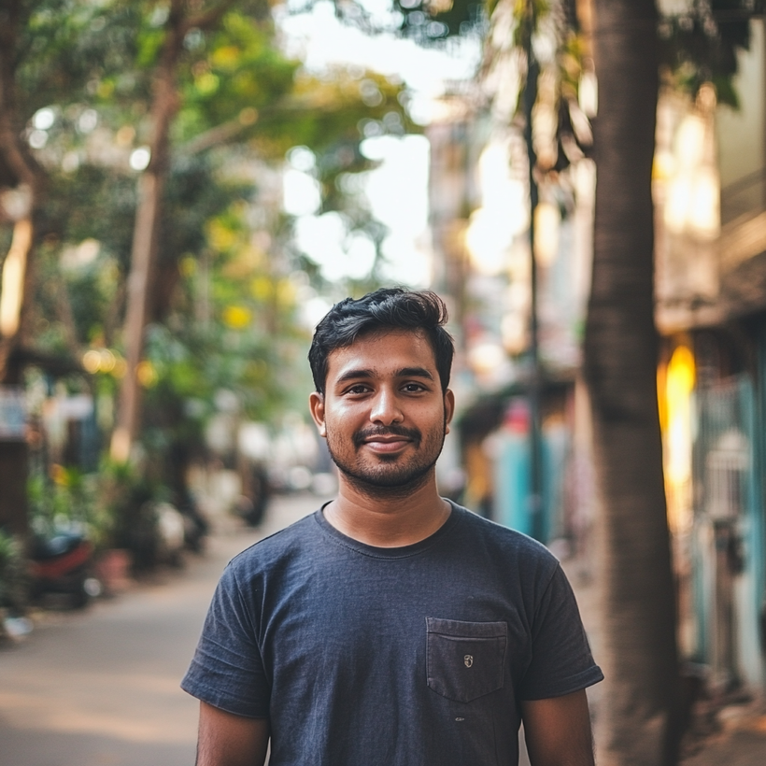



User Persona
Description
Personality
A tech-savvy professional who is passionate about leveraging technology to solve societal challenges. Rohan regularly volunteers for clean-up drives and is known for his leadership skills in organizing events within his workplace.
Leadership
Adaptibilty
Decision Making
Goals
Frustrations
Wants to create lasting community impact by using his skills and resources effectively.
Seeks opportunities to collaborate with like-minded individuals for social causes.
Aims to help improve transparency in donations and community projects.
Feels current platforms lack adequate features for collaboration.
Frustrated by the inefficiency in reporting and addressing community issues.
Finds it hard to stay updated about local volunteering opportunities.
Rohan Verma
Motivations
Hobbies & Interests
Software Developer
Believes in the power of collective action.
Inspired by the success stories of grassroots movements.
Finds personal satisfaction in helping underprivileged communities.
Coding for social good projects.
Trekking and participating in environmental conservation activities.
Playing chess and reading about sustainable living.
Age: 28
Location: Pune, India

Slide 11

“How can I use my tech skills to make a real difference?”
“There should be a better way to track and collaborate on community projects.”
“Are donations and efforts being used transparently?”
Volunteers regularly for clean-up drives
Organizes events at work
Explores tech solutions for social good
Participates in environmental and conservation activities
Empathy
mapping
Thinks
Does
Feels
Says
Frustrated by the lack of transparency and collaboration tools
Motivated and fulfilled when contributing to social causes
Inspired by collective action and grassroots change
Anxious about missing out on local volunteering opportunities
“We need better tools to organize and collaborate on community efforts.”
“I want to contribute more effectively using my skills.”
“It's hard to find and stay updated on real volunteering opportunities.”

Slide 12




User Persona
Description
Personality
A creative individual who uses her platform to promote social causes and community initiatives. Ananya frequently collaborates with NGOs to amplify their campaigns and raise awareness about pressing issues.
Leadership
Adaptibilty
Decision Making
Goals
Frustrations
Wants to use her skills to create a wider reach for community service initiatives.
Seeks an app that can streamline donation processes and improve participation in events.
Aims to educate her audience about local and global social challenges.
Struggles to find authentic organizations for collaboration.
Feels current apps don’t cater to the needs of creators who promote social causes.
Lacks tools to track the impact of her contributions.
Ananya Singh
Motivations
Hobbies & Interests
Content Creator
Finds joy in seeing her content inspire others to take action.
Motivated by the opportunity to connect people with meaningful causes.
Drawn to platforms that align with her values of compassion and empathy.
Photography and storytelling for social impact.
Traveling to learn about different cultures and their challenges.
Organizing community meetups and workshops.
Age: 24
Location: Jaipur, India

Slide 13
How can I use my content to inspire real social change?”
“Is this NGO or campaign authentic and trustworthy?”
“I wish there was an easier way to manage donations and partnerships.”
Collaborates with NGOs and raises awareness online
Creates and shares content around social causes
Organizes and participates in community events
Travels to explore social issues and cultural challenges
Empathy
mapping
Thinks
Does
Feels
Says
Frustrated by the lack of tools that support impact creators
Passionate about authentic connections and causes
Inspired when her work influences others to take action
Concerned about the transparency of donations and collaborations
“I want to collaborate with causes that are genuinely impactful.”
“It’s hard to measure the outcome of what I contribute.”
“I need tools that make donation drives and awareness campaigns easier to manage.”

Slide 14
User Journey Map
Search
Enter
Engage
Exit
Limited discovery of genuine opportunities
Lack of peer interaction or guidance
Initial app setup may feel overwhelming
No reminder/follow-up mechanism
Discoverability
& Trust
Onboarding
& Relevance
Belonging
& Motivation
Reflection
& Closure
Searches for volunteering platforms
Finds WeServe
Registers as Individual
Finds Relevant Cause
Joins Event
Participates on-site
Engages with other Volunteers
Submits Feedback
Leaves a Review
Journey
Downloads App
Explores Homepage
Shares Experience

Slide 15

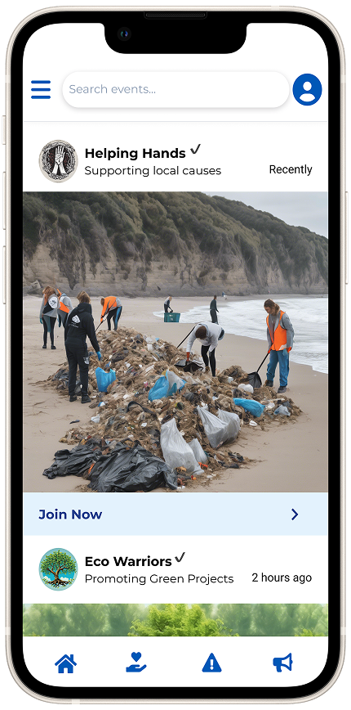
WeServe
We Serve is an integrated community engagement app designed to empower individuals, organizations, and civic bodies to collaborate for social good. The platform enables users to discover and join volunteer opportunities, report local civic issues, access emergency assistance through real-time SOS features, and support NGOs through transparent donation systems. It also offers personalized dashboards for both individuals and organizations to track events, contributions, and impact. By combining service, safety, and social responsibility in one seamless experience, We Serve fosters more connected, responsive, and empowered communities.

Slide 16
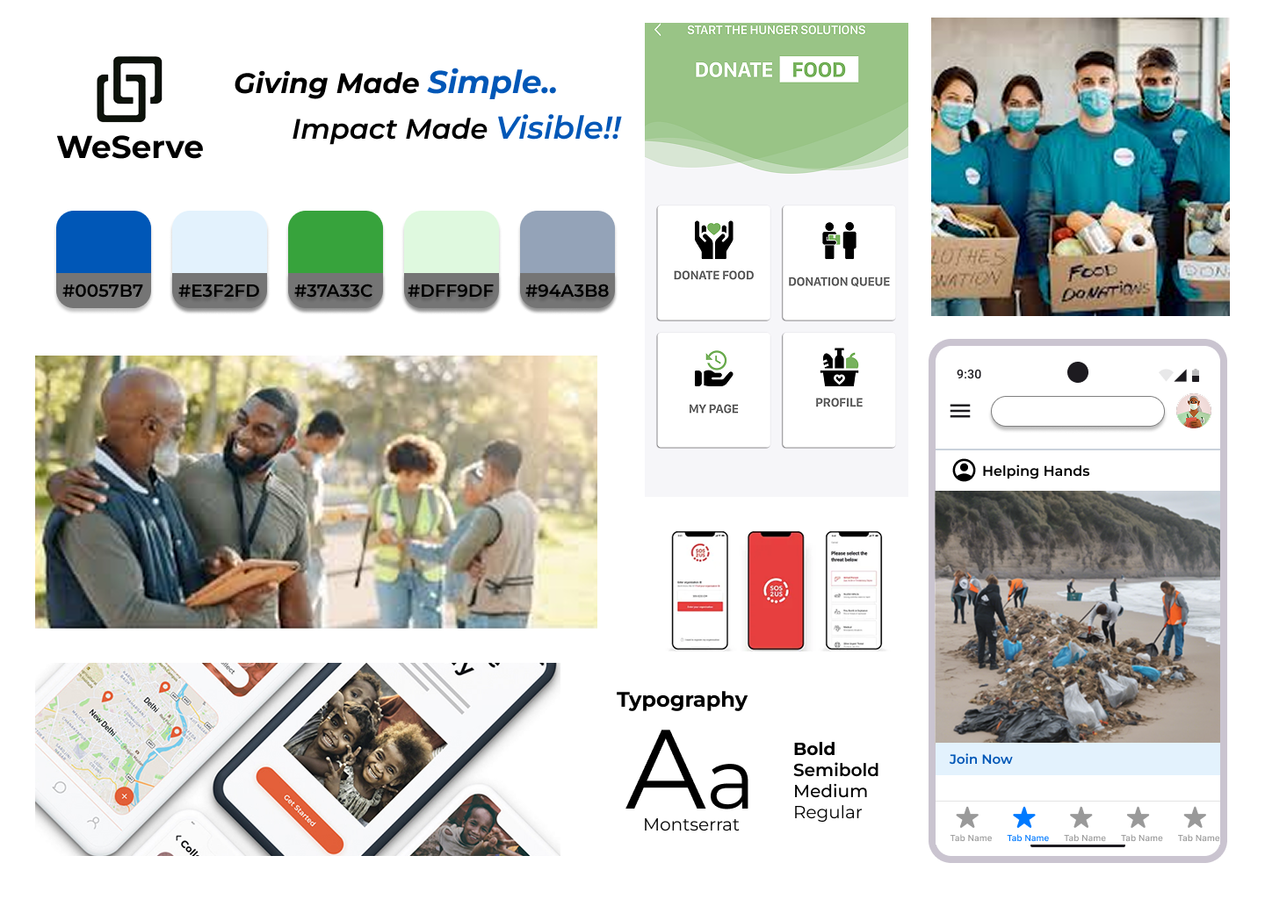
Moodboard

Slide 17
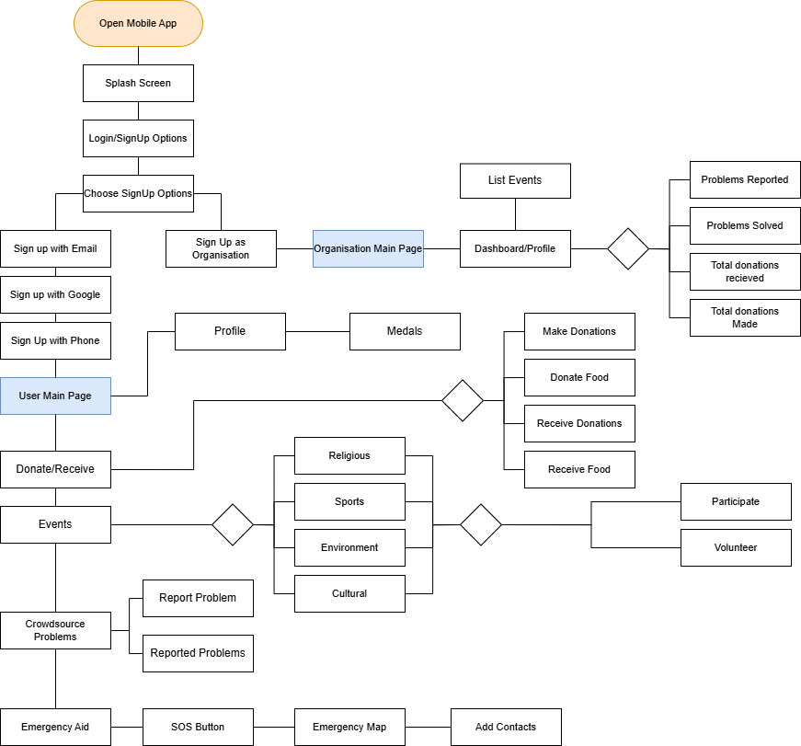
Flowchart

Slide 18

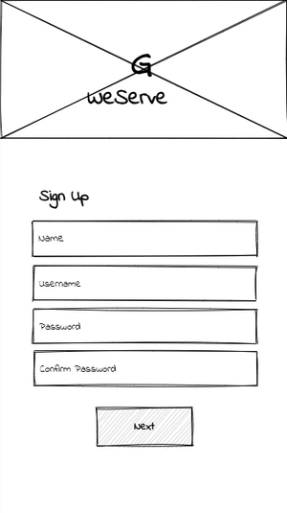
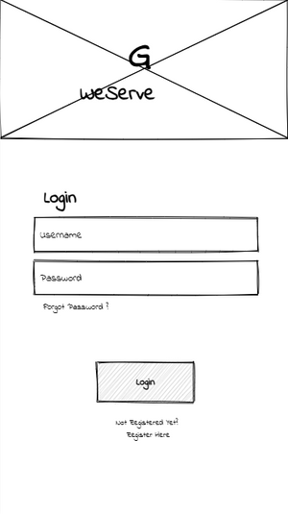
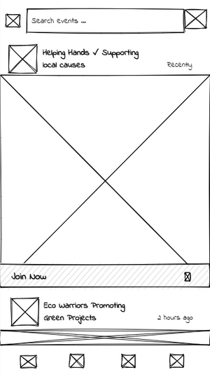
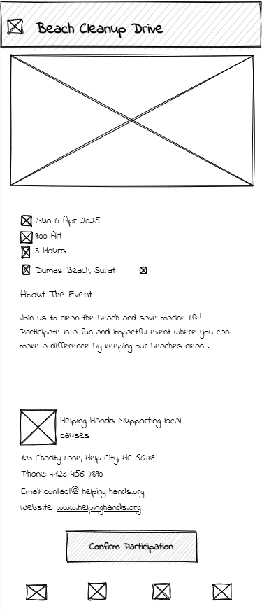
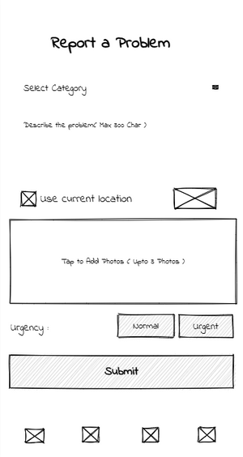
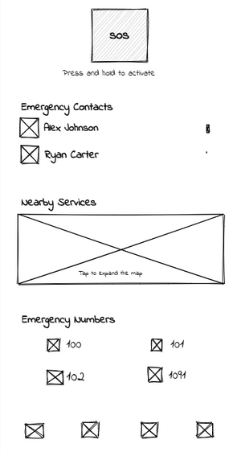
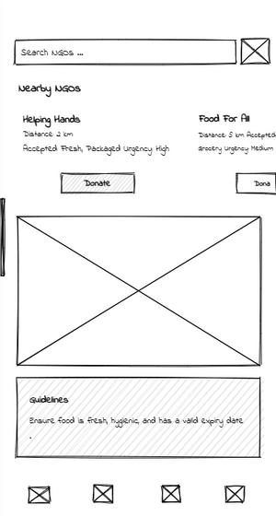
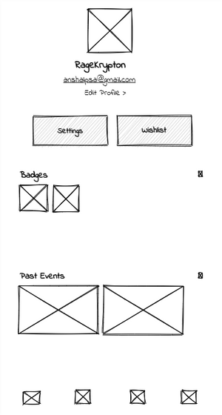
WeServe
WeServe
Low fidelity wireframes

Slide 19
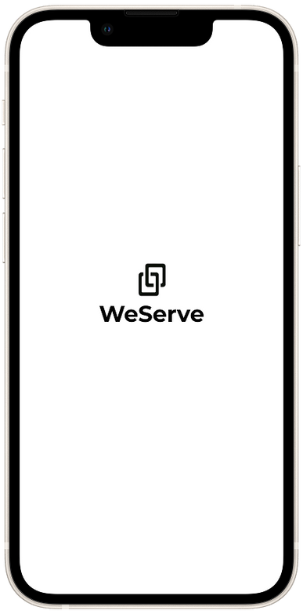
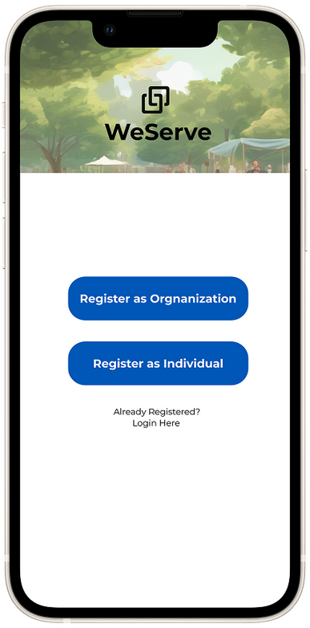
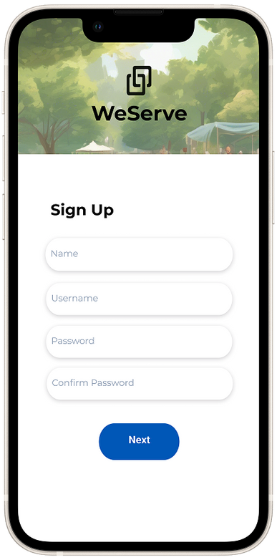
WeServe
User Onboarding Screens – We Serve
Splash Screen
Clean design with logo for strong brand recall.
Sets a professional and welcoming tone.
User Type Selection
Option to register as Individual or Organization.
Ensures tailored experiences for different user roles.
Sign-Up Screen
Simple, user-friendly form for quick registration.
Focuses on ease of use and accessibility.

Slide 20
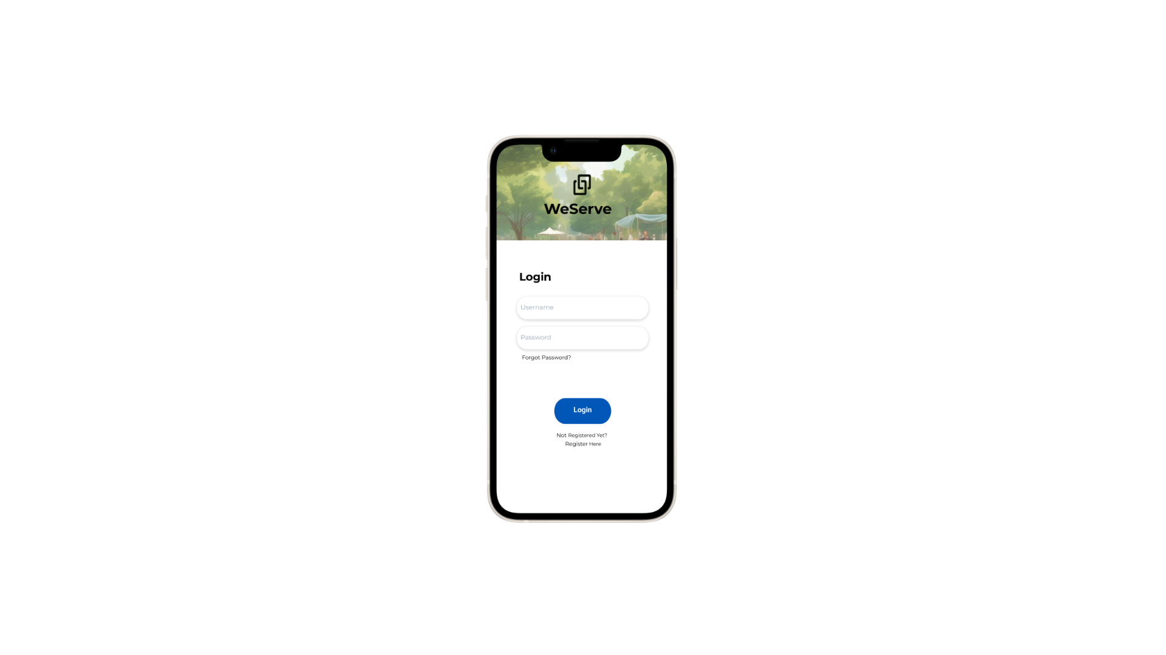
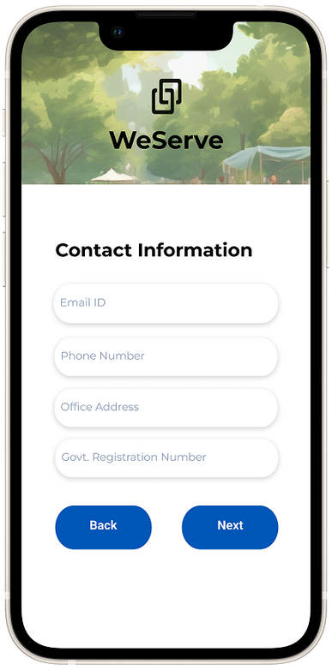
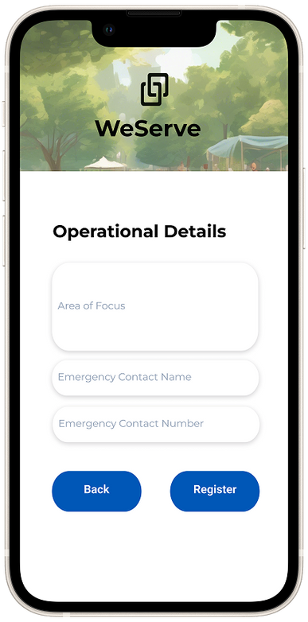
Contact Information Screen
Collects essential details like email, phone, office address, and registration number.
Ensures credibility and verification of organizations.
Operational Details Screen
Captures area of focus and emergency contact info.
Helps tailor features and services to each organization’s needs.
Login Screen (Upcoming)
Will allow registered users to securely access their dashboard.
Enables streamlined event and donation management post-registration.
WeServe

Slide 21
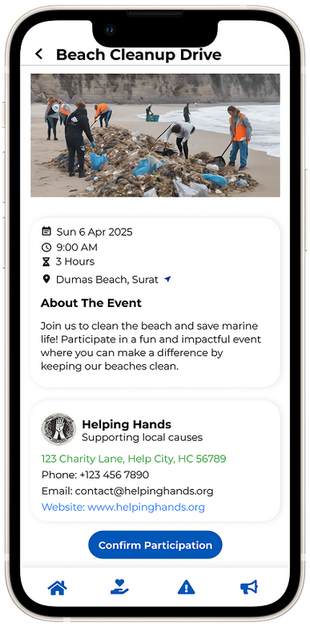
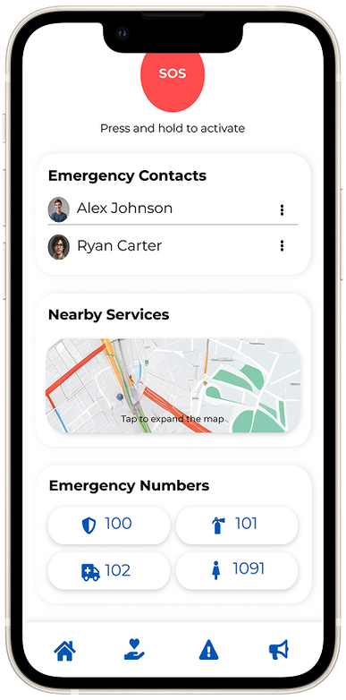
Event Discovery
Browse and join community service events.
Quick access to NGO details and participation.
Event Details
View full event info with location and organizer contact.
Confirm participation directly.
Emergency SOS
Quick SOS trigger with contacts, nearby services, and helpline numbers.
Prioritizes user safety in real-time situations.
WeServe

Slide 22
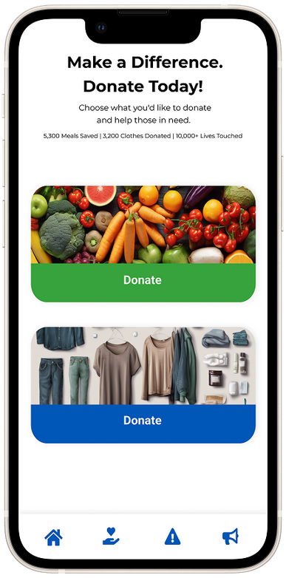
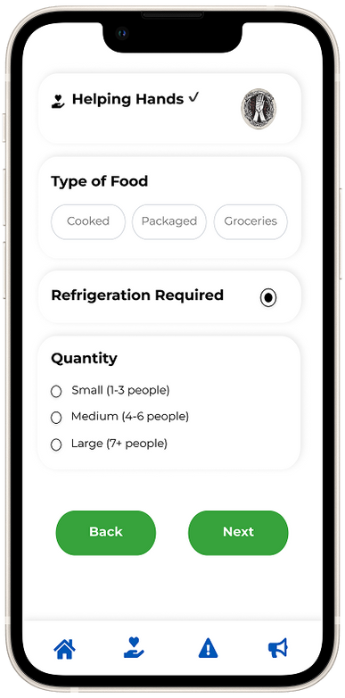
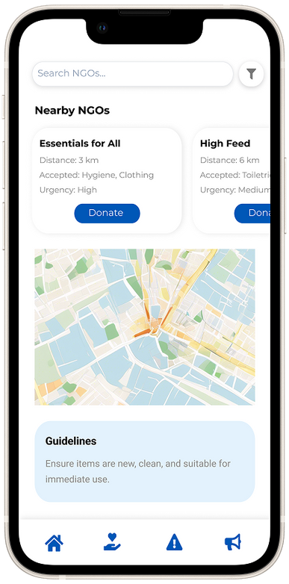
WeServe
Donation Options
Users can select categories like food or clothes to donate.
Clean visuals and clear CTAs encourage immediate action.
Item Details Input
Easy form to specify type, refrigeration need, and quantity.
Designed for quick submissions with minimal effort.
NGO Matching & Map View
Displays nearby NGOs with donation needs.
Includes map integration and donation guidelines for clarity.

Slide 23
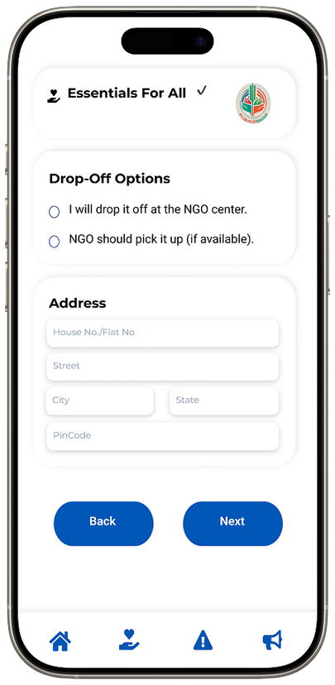
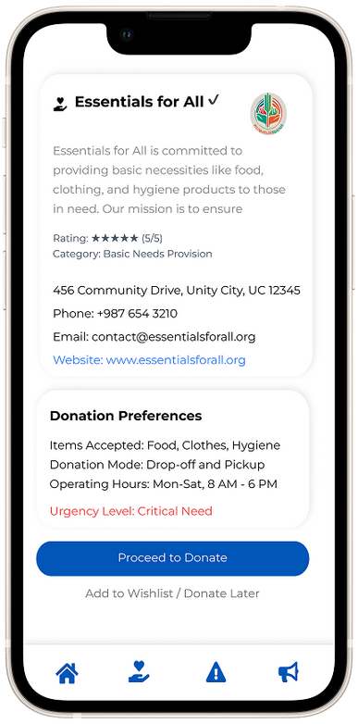
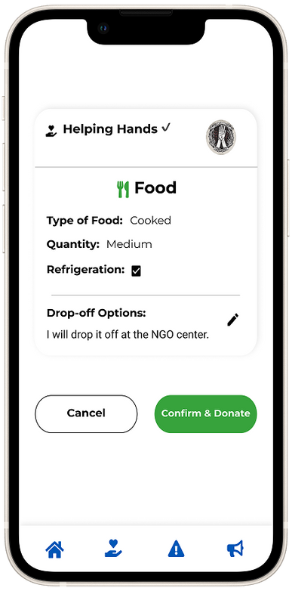
WeServe
Drop-Off Selection Screen
Lets users choose between NGO pickup or drop-off.
Includes address input for logistics coordination.
NGO Details Screen
Displays NGO’s mission, contact, and donation preferences.
Adds transparency and builds donor trust.
Confirmation Screen
Summarizes donation details before final submission.
Simple “Confirm & Donate” CTA ensures a smooth finish.

Slide 24
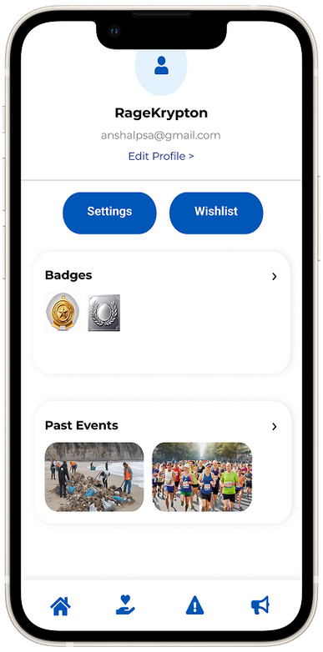
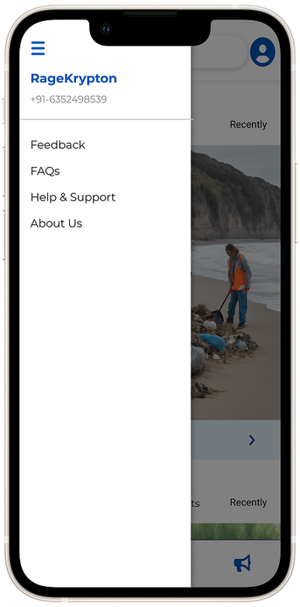
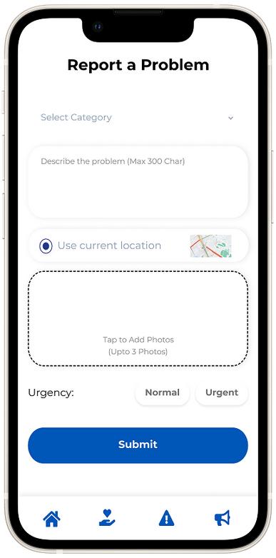
WeServe
Profile Screen :
Shows user info with options to edit profile, access settings/wishlist, view badges, and past events.
Navigation Drawer :
A clean sidebar with quick links to Feedback, FAQs, Help & Support, and About Us.
Report a Problem :
Allows users to select a category, describe the issue, attach media, share location, and set urgency before submitting.

Slide 25
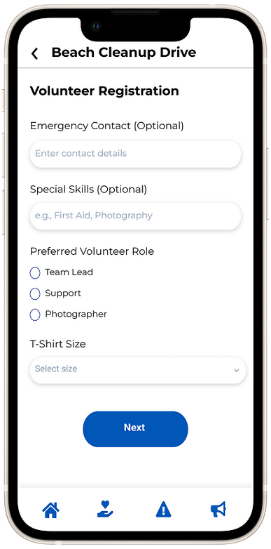
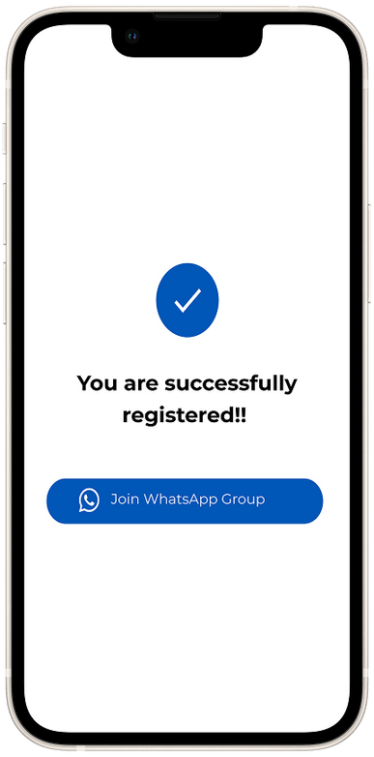
WeServe
Volunteer Registration Form :
Users provide optional details like emergency contact and skills, choose a preferred role (Team Lead, Support, Photographer), and select a t-shirt size before proceeding.
Confirmation Screen :
A simple success message confirms registration, with a CTA to Join WhatsApp Group for further coordination.

Slide 26


Team We Serve (Group 17) :-
Siddhant Gupta (202201272)
Ansh Garg(202201343)
Bhavya Shah(202201366)

